Slide 1

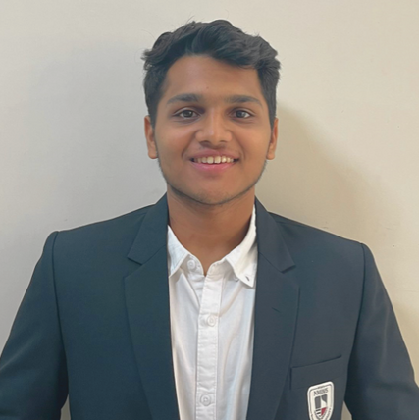
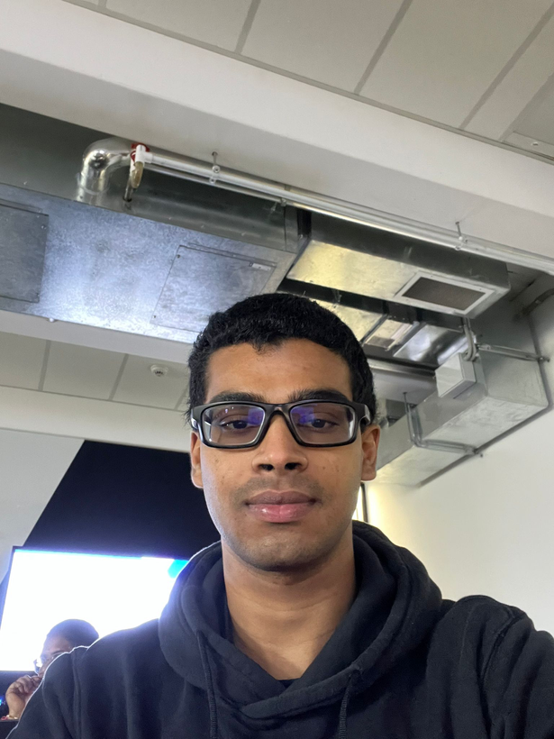
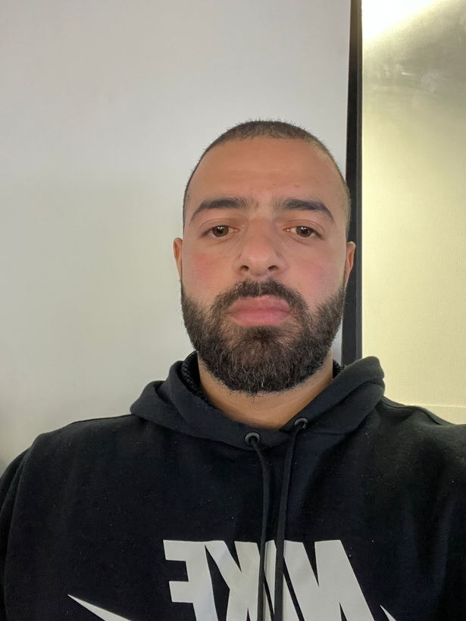
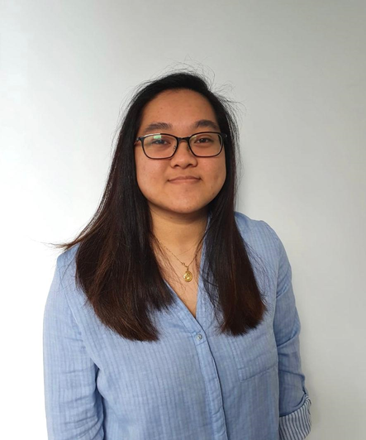


GROUP 10
La Trobe Clinical Trials
Sahil Mehta
Project Manager
Sanidu Gonsal
Finance Manager
Khalil Yarak
Software Developer
Sharlyn Chan
Business Analyst

Slide 2

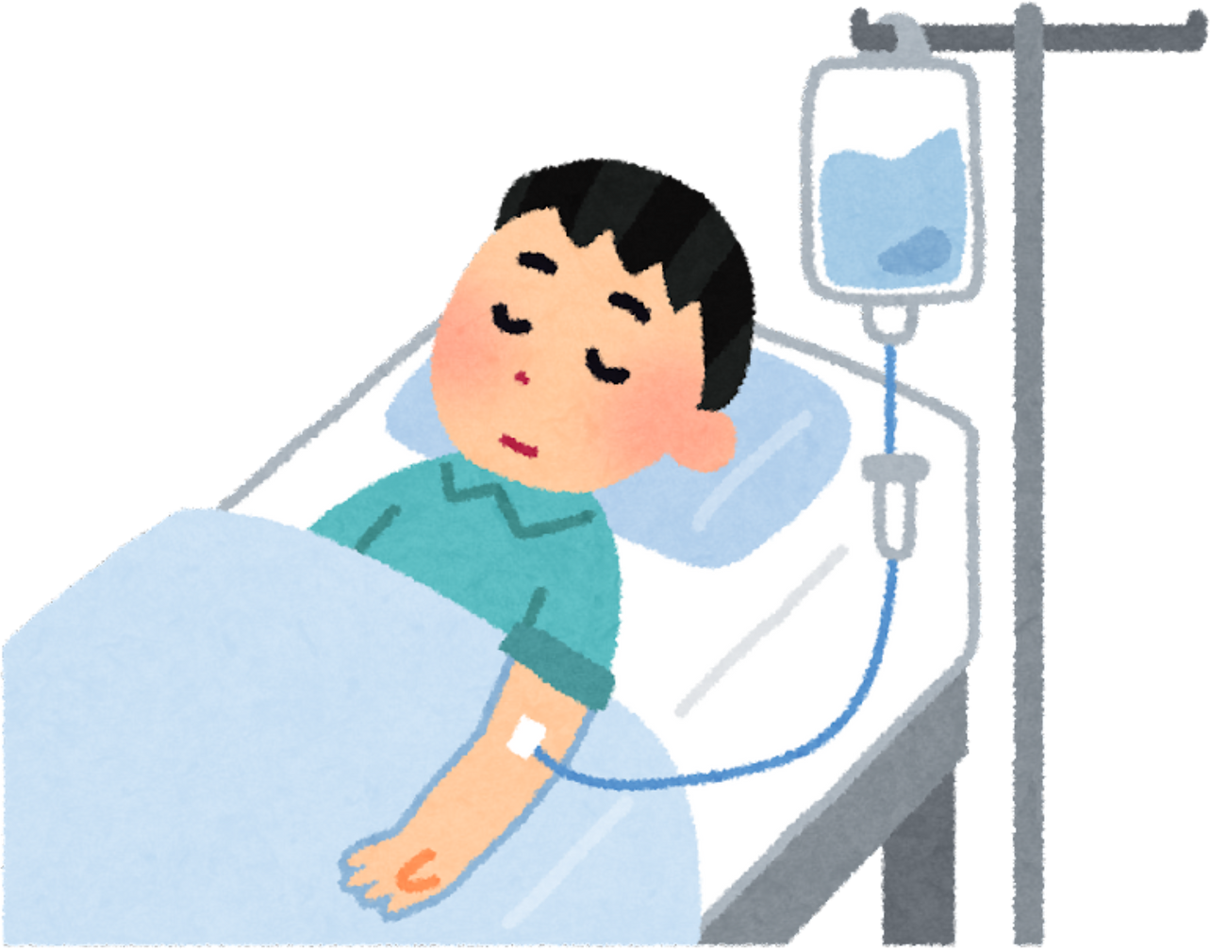
LATROBE CLINICAL TRIALS | GROUP 10
DID YOU KNOW?

Slide 3
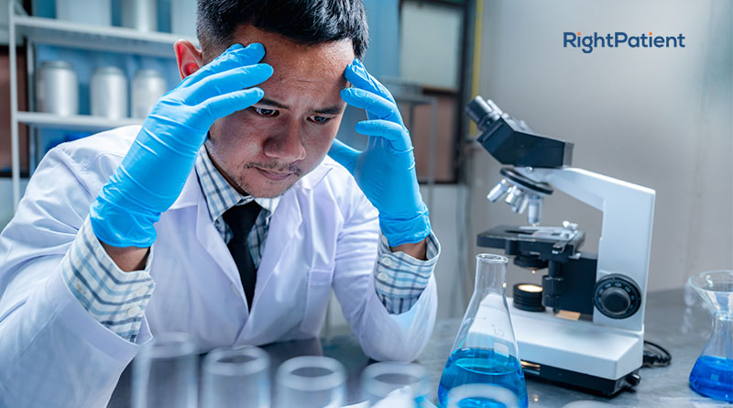
HURDLES OF TRIALS
LATROBE CLINICAL TRIALS | GROUP 10

Slide 4


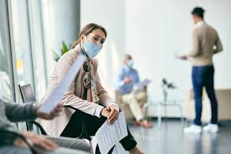
LATROBE CLINICAL TRIALS | GROUP 10
Recruiting and retaining participants.
Lengthy volunteer registration process.

Slide 5


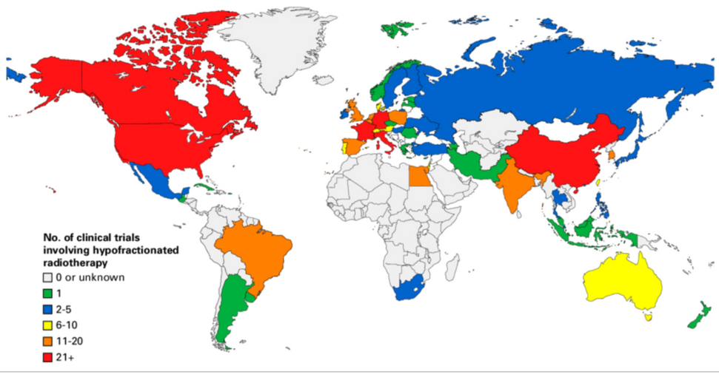

LATROBE CLINICAL TRIALS | GROUP 10
Geographic limitations.
Rights and responsibilities

Slide 6
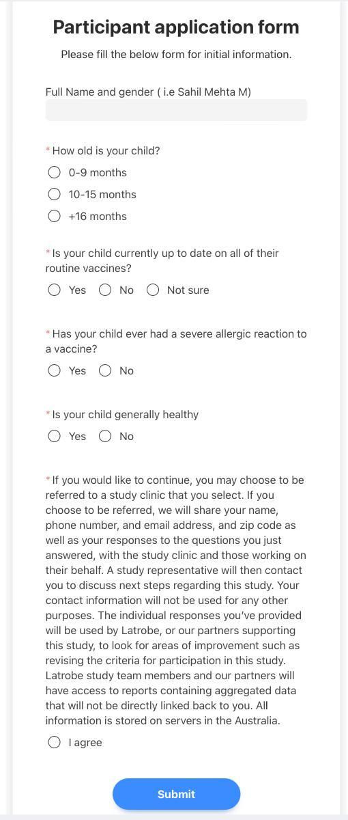
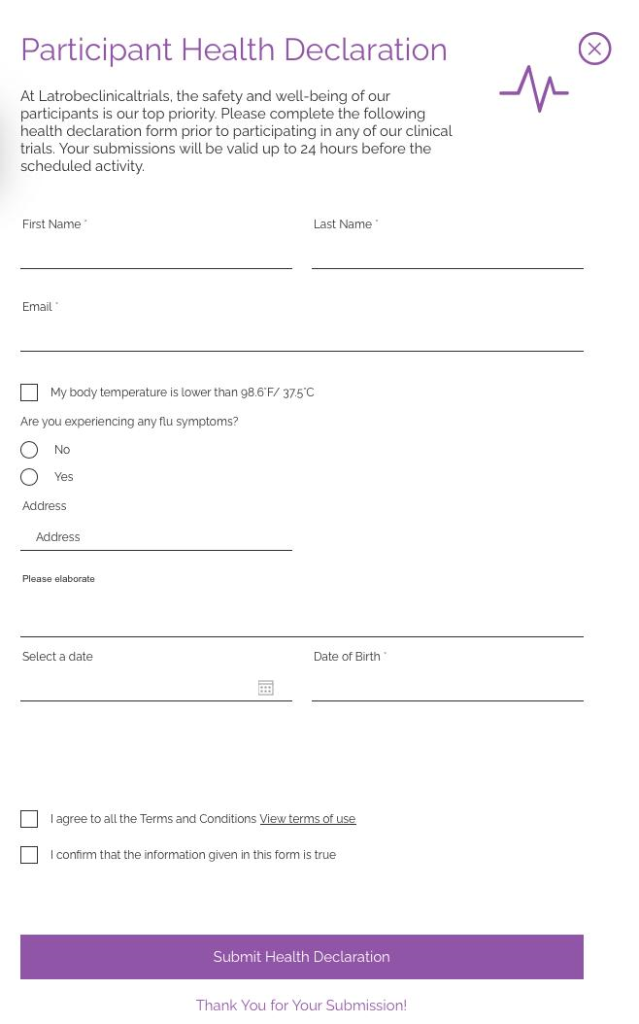

LATROBE CLINICAL TRIALS | GROUP 10

Slide 7





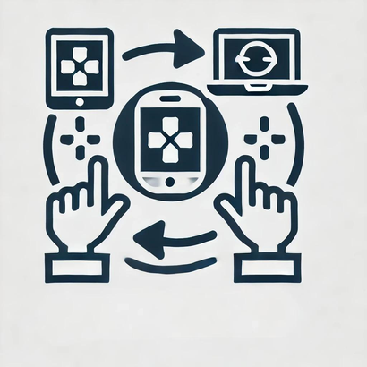


Quality Standards
1-Functional Measure
2-Non-functional measure
3-Performance
4-Security
5-Accuracy
6-Comptability
7-Reliability
8-Flexibility
LATROBE CLINICAL TRIALS | GROUP 10

Slide 8

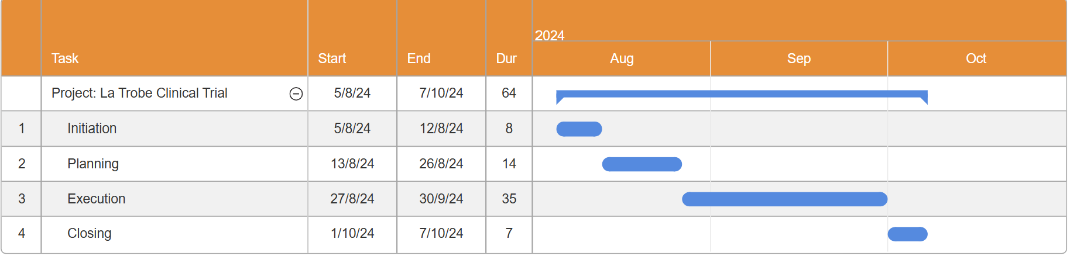
Project Timeline
LATROBE CLINICAL TRIALS | GROUP 10

Slide 9



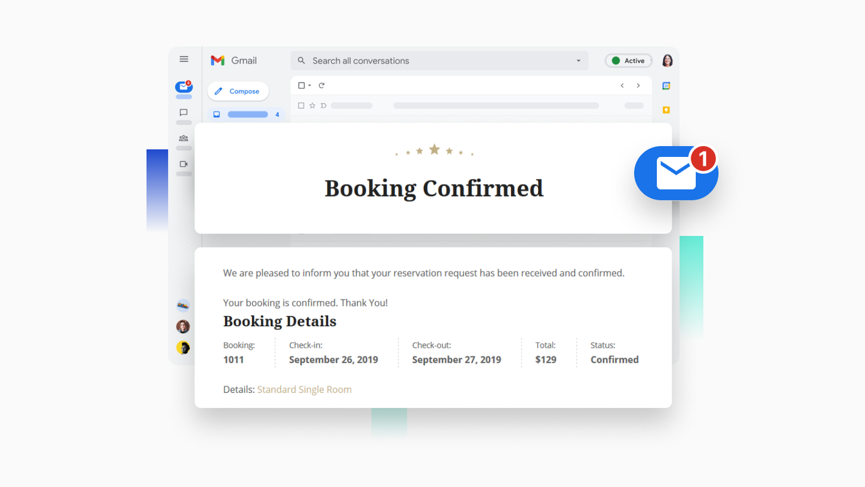

Measures of Sucess
60% participants complete the booking process in 50% time in first 2 months.
20% increase in the conversion rate of participants who complete a booking.
100% response rate for terms and conditions form and no law cases on the org.
LATROBE CLINICAL TRIALS | GROUP 10

Slide 10


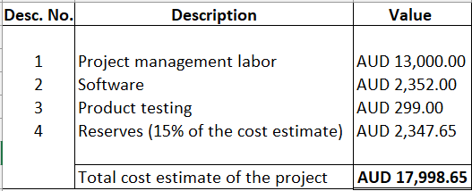
Utilisation of the principle amount
LATROBE CLINICAL TRIALS | GROUP 10

Slide 11




Challenges we overcame
LATROBE CLINICAL TRIALS | GROUP 10

Slide 12
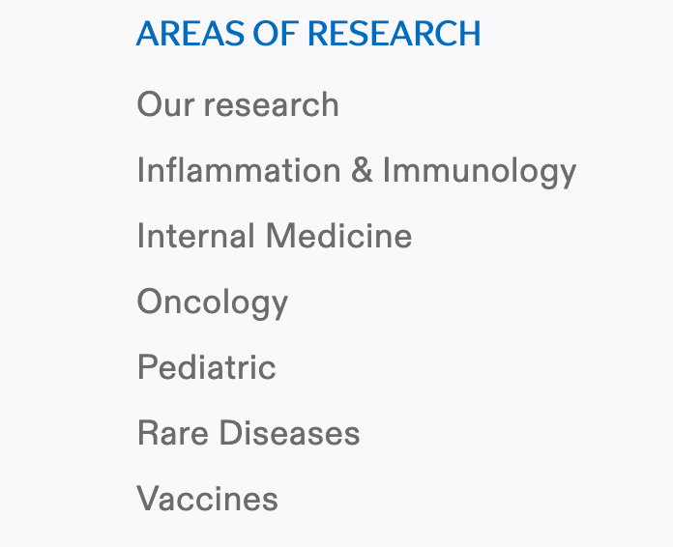

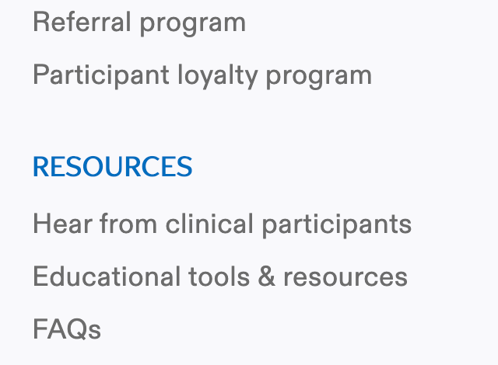

Future Prospects
Growth after reaching the saturation

Slide 13



Slide 14
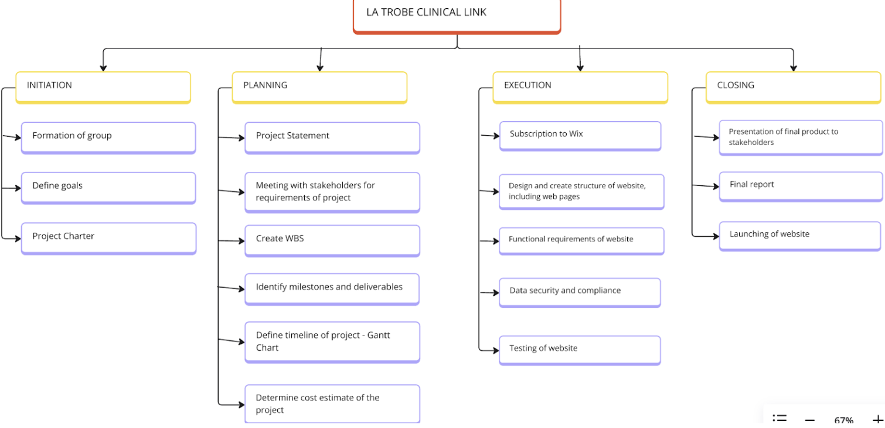
Work Breakdown structure

Slide 15
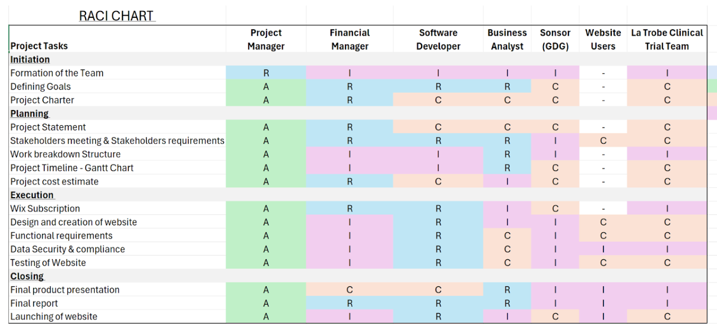
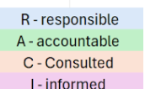

Slide 16
